Slide 1

Environmental monitoring
_{Name: E. PRITHISHA}
_{Reg no:422121106023}

Slide 2
Innovation of project
Development part 2:
In this technology project you will continue building your project by developing the platform as per
project requirement. Use web development technologies wherever needed. After performing the
relevant activities create a document around it and share the same for assessment.

Slide 3
On the project of phase 4
In phase 3 we will simulation the environment monitoring of temperature and humidity monitoring will be conducted
In phase 4 we will explain the above process of environmental monitoring with net diagram

Slide 4
Introduction of project
I can give you an induction on environmental monitoring! Environmental monitoring is the process of collecting data about the environment to assess its quality and make informed decisions. It involves using sensors to measure various parameters such as air quality, water quality, temperature, and humidity. The collected data is then analyzed to identify any potential issues or trends. This information helps in understanding the current state of the environment and taking necessary actions to protect and improve it. Let me know if you have any specific questions or if there's anything else I can assist you with.

Slide 5
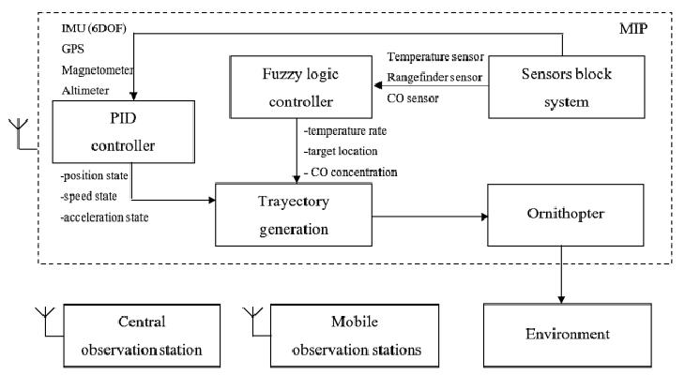
Environmental monitoring diagram

Slide 6
Working of diagram
I can help you with an environmental monitoring program! An environmental monitoring program typically involves setting up sensors to collect data on various environmental parameters such as air quality, water quality, temperature, and humidity. This data is then analyzed to assess the environmental conditions and identify any potential issues or trends. The program can also include regular monitoring, data logging, and reporting to ensure ongoing environmental awareness. Let me know if you need more specific information or guidance on setting up an environmental monitoring program.

Slide 7
Program
#include <stdio.h> #include <stdlib.h> #include <time.h> double readEnvironmentalData() { return 25.5; } int main() { FILE *file; char filename[] = “environmental_data.log”; file = fopen(filename, “a”);

Slide 8
....
if (file == NULL) { printf(“Error opening the file.\n”); return 1; } time_t rawtime; struct tm *timeinfo; time(&rawtime); timeinfo = localtime(&rawtime); double environmentalData = readEnvironmentalData(); fprintf(file, “Timestamp: %s”, asctime(timeinfo)); fprintf(file, “Environmental Data: %lf\n”, environmentalData); fclose(file); return 0; }

Slide 9
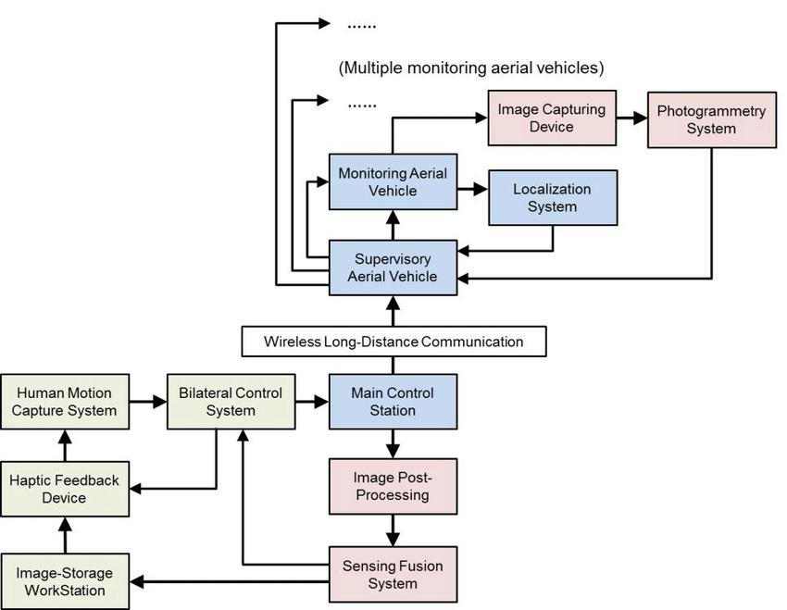
Flow diagram

Slide 10
Related works
I can help you with environmental monitoring-related work! Environmental monitoring involves collecting data about the environment to assess its quality and make informed decisions. This can include monitoring air quality, water quality, temperature, humidity, and more. By using sensors and data analysis techniques, you can gather valuable insights to understand and improve environmental conditions. Let me know if you have any specific questions or if there’s anything else I can assist you with.

Slide 11
Conclusion
Based on the information you provided, the working principle of the ESP32 microcontroller involves its ability to monitor and simulate environmental conditions. It can collect data from various sensors and simulate different scenarios for environmental monitoring. Let me know if you'd like more details.

Slide 12

....

